Slide 1
Intro to Azure Container Service
Diego Martínez
diego.martinez@microsoft.com
@diegomrtnzg

Slide 2
Microservices is an architectural pattern, containers is a tech that often helps.

Slide 3
Containers

Slide 4
Containers vs. VM’s
App
A
App
A
App
B
App
C
Virtual Machines
Each VM has independent, full OS
Full isolation
Separate app frameworks
Support features such as live migration
Containers
Shared Host OS
Near instant start-up
Processes in containers are isolated
Dependent app services and libraries are tied to container (layers)
All containers on a host will share the same guest OS version
App
Framework
App
Framework
App
Framework
App
Framework
VM
Guest OS
Guest OS
Guest OS
Guest OS
Hypervisor
Physical Server
App
A
App
A
App
B
App
B
App
C
App
C
Container
App
Framework
App
Framework
App
Framework
Guest OS w/ Docker
Hypervisor
Physical Server

Slide 5
Why containers?
Repeatable execution
immutable environment
reusable and portable code (“Build, Ship, and Run”)
Consistency across development, test, & production
Fast & agile app deployment; instant startup
Cloud portability
Density, partitioning, scale
Diverse developer framework support
Microservices

Slide 6
Containers offer unique capabilities
Fast iteration
Defined state separation
Resource controls
Immutability
Rapid deployment

Slide 7
Constructing a Container
Container tied to dependencies
Base image
Added files, binaries, libraries
App platforms. Eg – MongoDB, apache, node.js, etc.
Configuration changes
Networking
Custom code
Entry Point
Can think of these as “layers”
One can build new layers on top of an existing container
Docker will pull these required dependencies to install/run

Slide 8
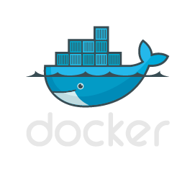
Web
API
DB
Container Image Repository
Deploy containers
Publish
Pull images
Create images
Web
Web
Web
API
API
DB
Update, customize, add code

Slide 9

Containers offer ideal support
Distributed compute
Scale out
Databases
Tasks
Web
$$f\left(x\right)$$

Slide 10
Azure Container Service

Slide 11
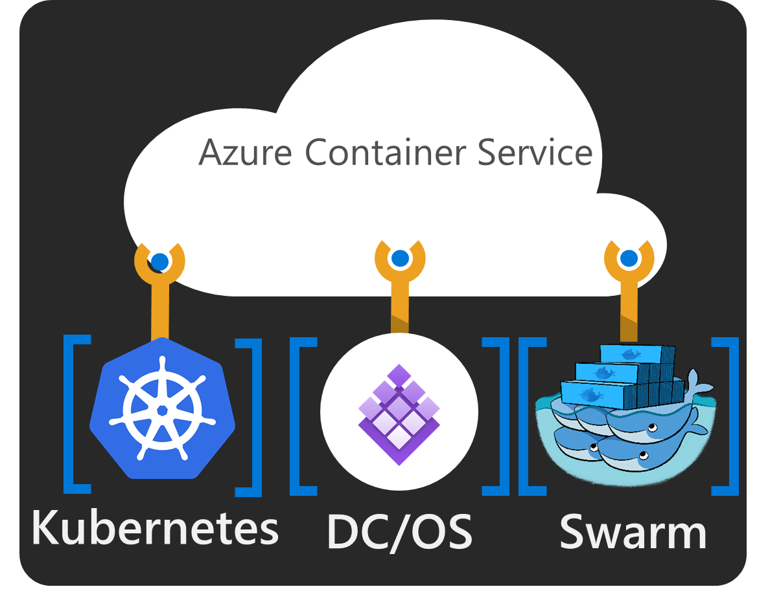
ACS: The best place to run your containers
Standard Docker tooling and API support
Streamlined provisioning of DCOS, Docker Swarm and Kubernetes (preview)
Linux and Windows Server containers
Azure and Azure Stack

Slide 12
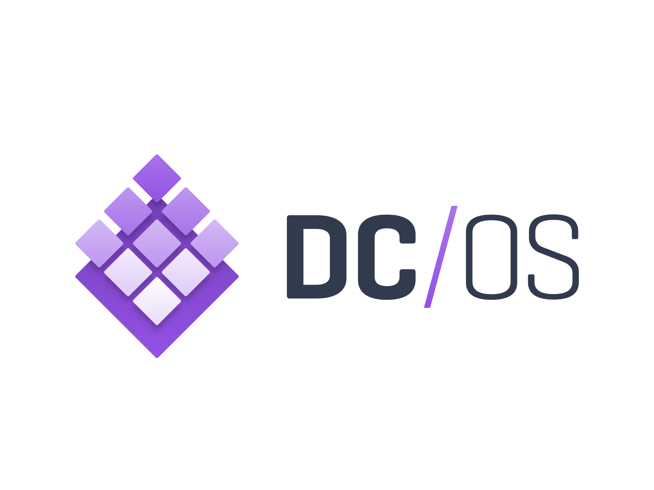

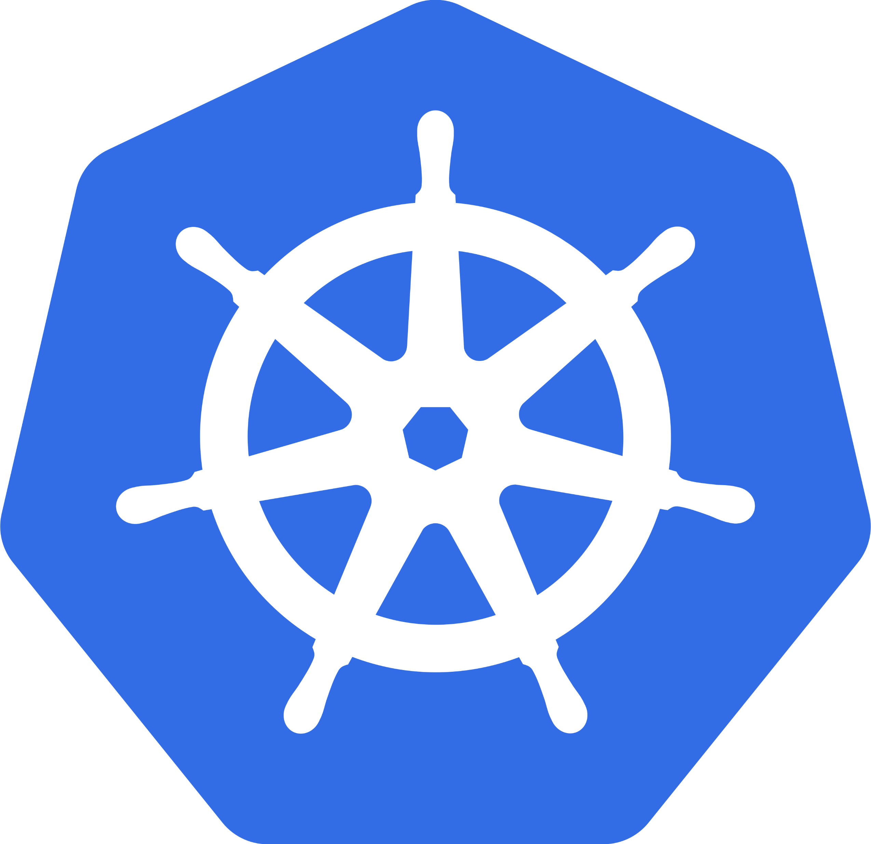
Azure Container Service
Deploy and manage containers using the tools you choose
Create an optimized container hosting solution
Manage container applications using familiar tools
Scale and orchestrate using Mesosphere DC/OS, Docker Swarm, or Kubernetes
Use popular open source tooling
Migrate container workloads to and from Azure
Full support from Microsoft / Docker / Mesosphere
Leverage Azure Platform capabilities
Azure Resource Manager
VM Scale Sets
Networking
Security

Slide 13


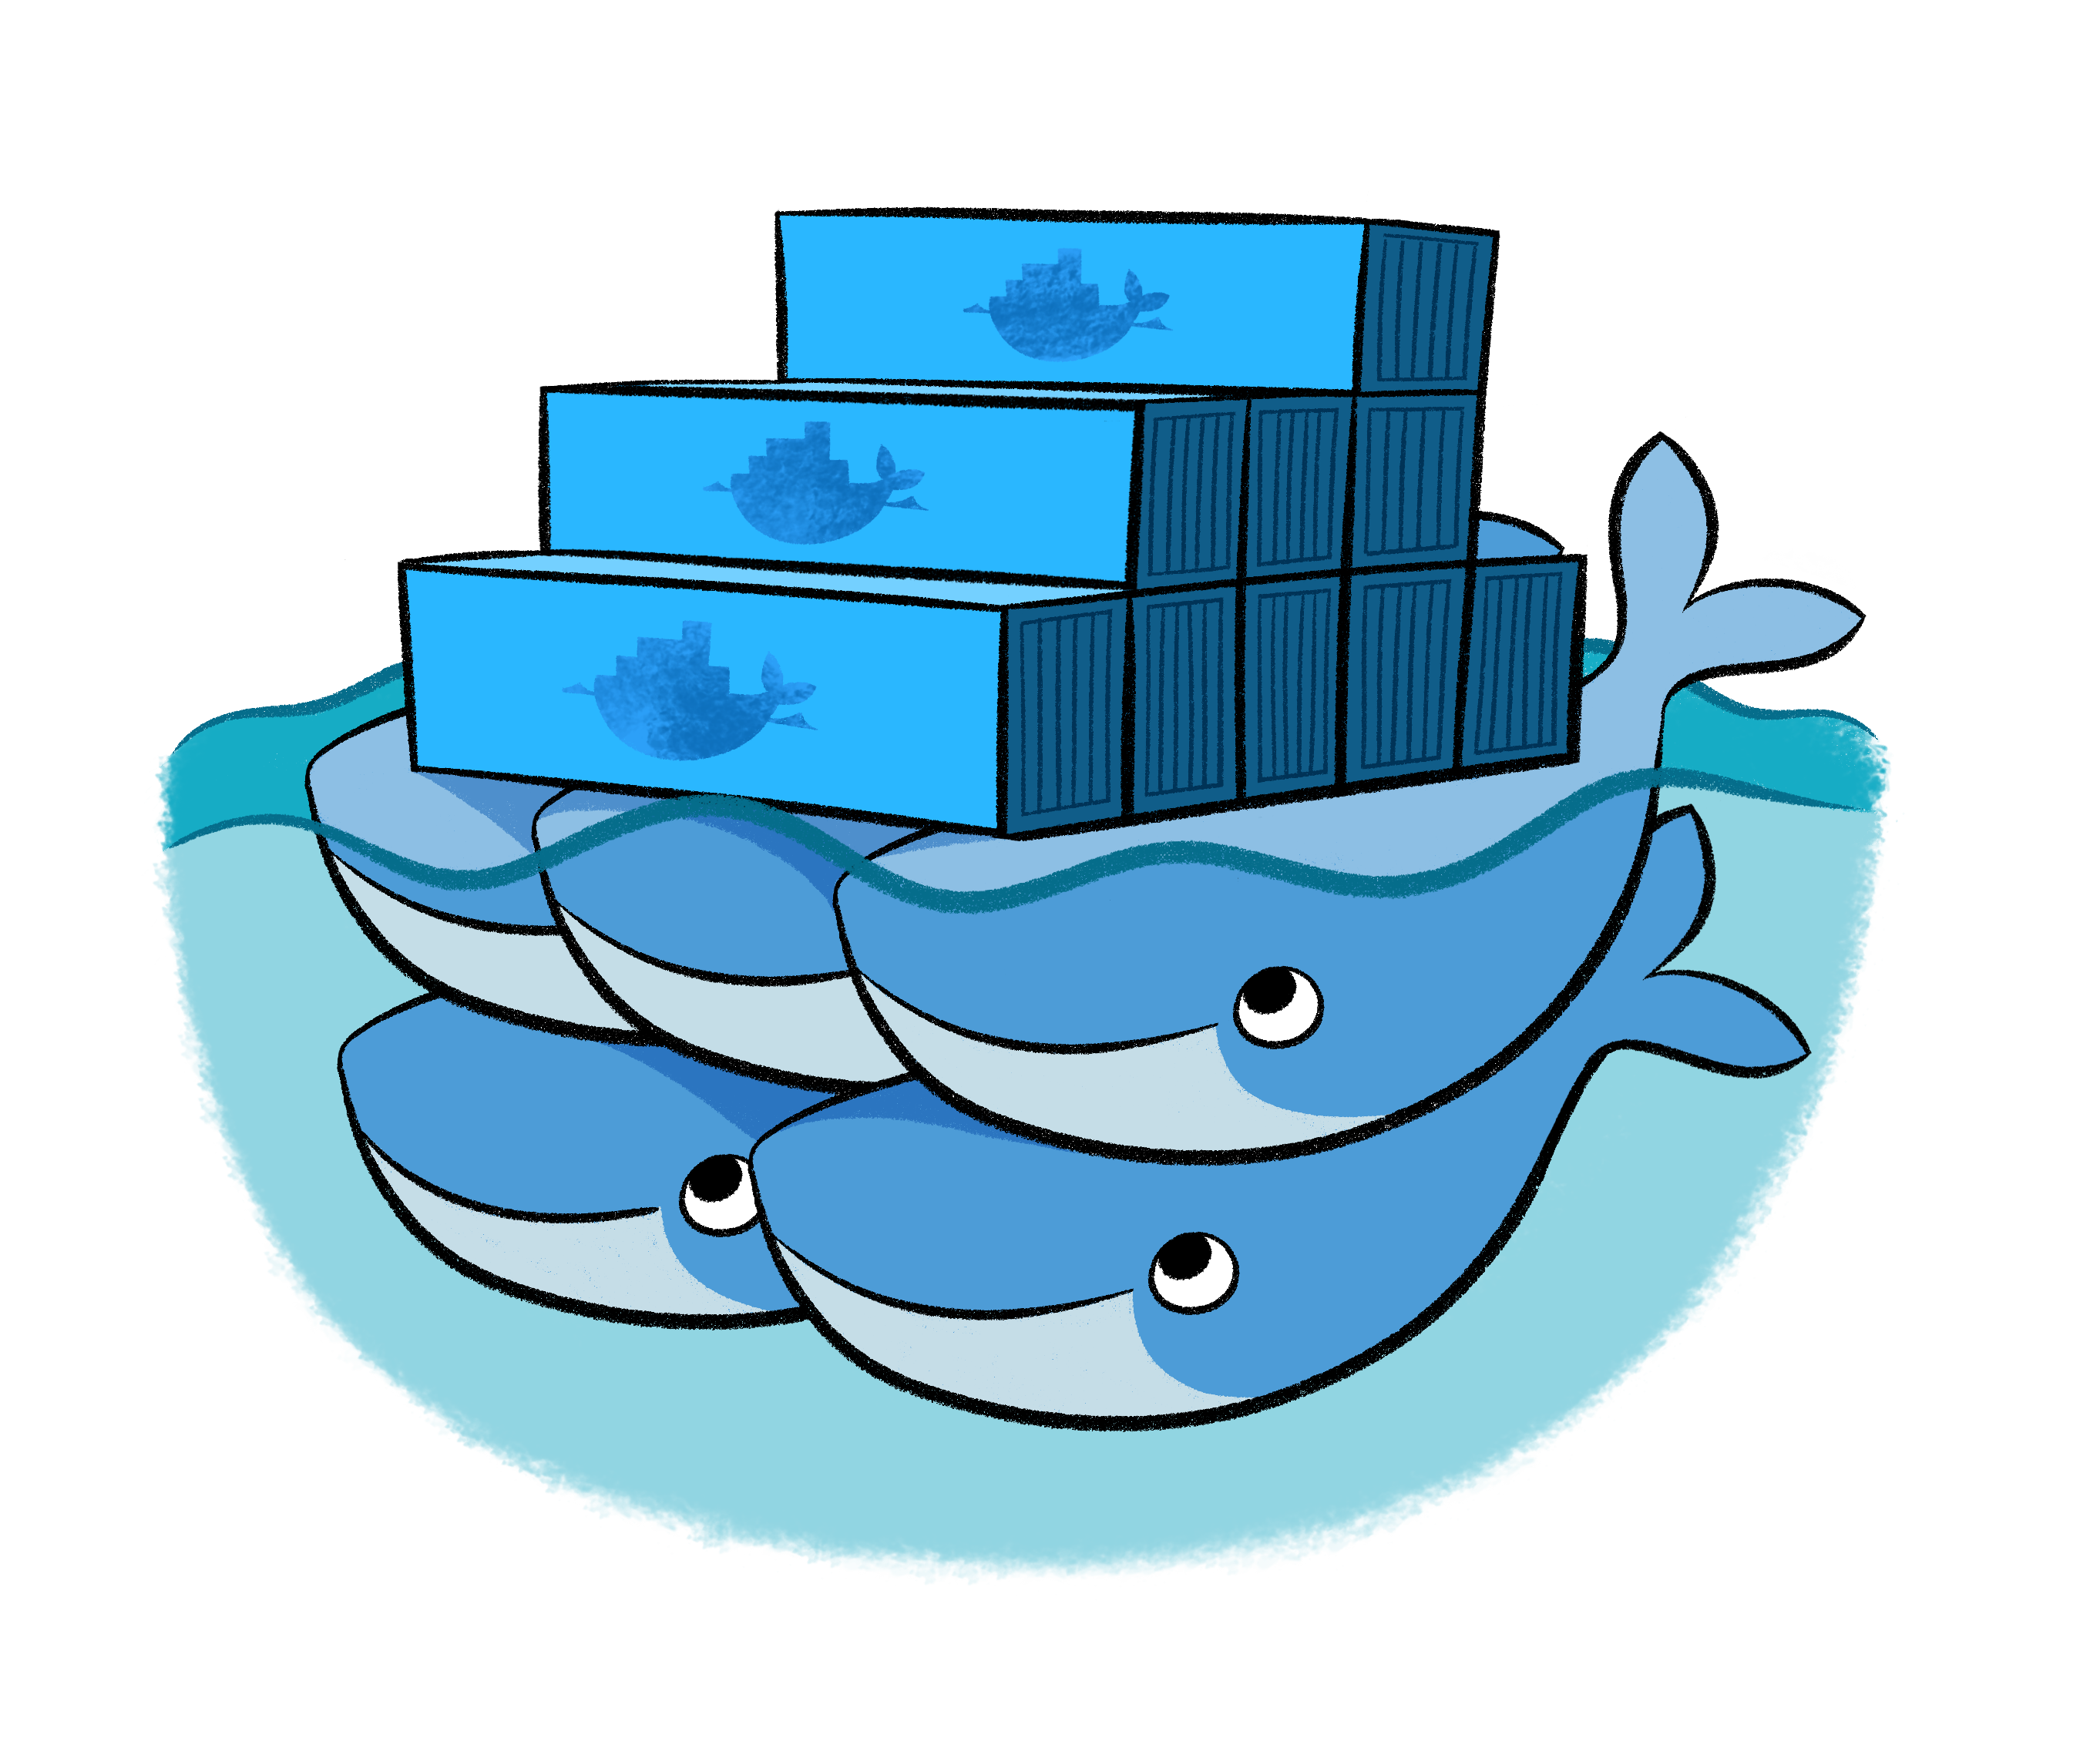
Azure Container Service
Application
Orchestrator
ARM
Infrastructure

Slide 14
Azure Container Service
Service Tooling
Container Tooling
Layer | Supported Technologies
Configuration as Code | ARM, Dockerfile, Docker Compose, Marathon.json
Host cluster management | VM Scale Sets, Availability Sets
Container orchestration | Docker Swarm, Marathon, Apache Mesos
Monitoring | OMS, Statsd, Fluentd, cAdvisor, ELK
Networking | Docker Network Plugin
Storage | Docker Storage Plugin
Registry | Azure Container Registry, Docker Hub…
ARM Template
Containers
Container Services (1st party, 3rd party)
Windows Server
Linux
VMs and VM Scale Sets
Azure Stack
Azure

Slide 15
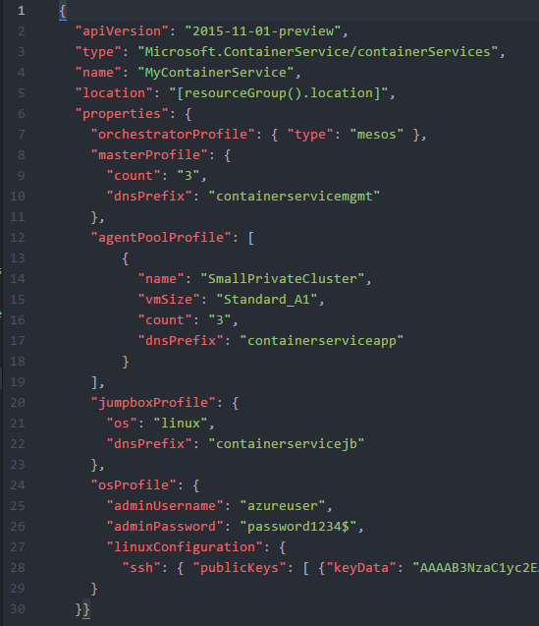
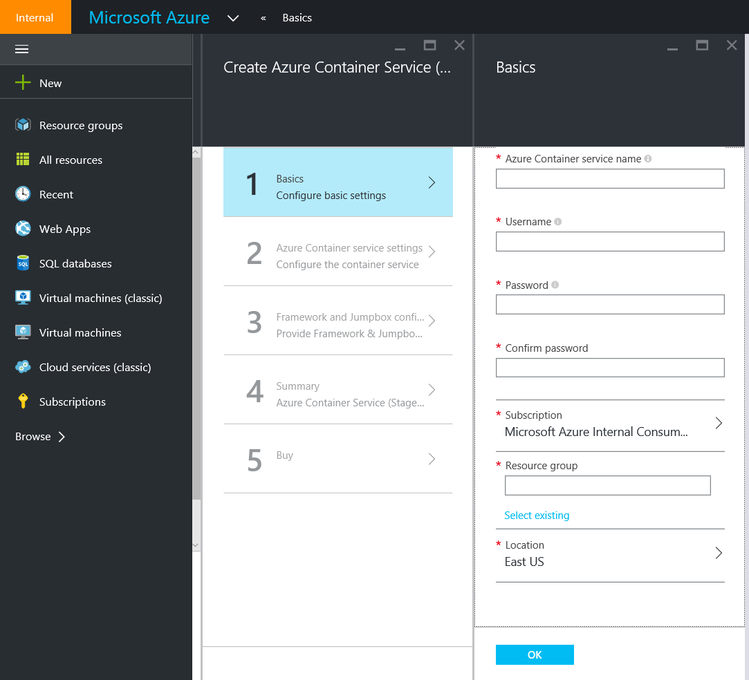
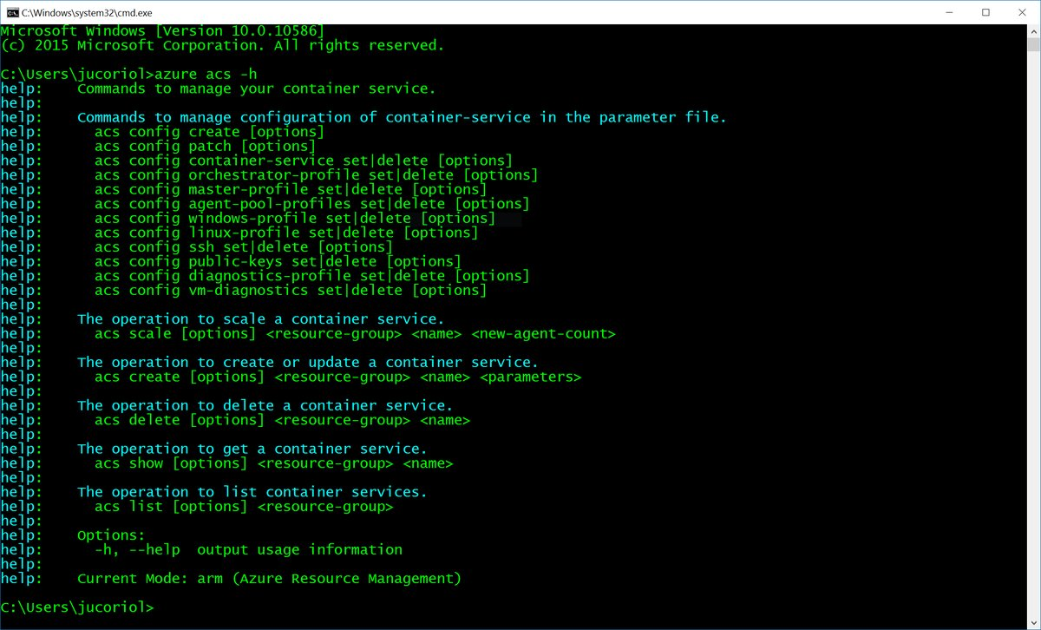
Deploy using Portal, CLI, or ARM

Slide 16
Try Azure Container Service http://aka.ms/try-acs
Diego Martínez
diego.martinez@microsoft.com
@diegomrtnzg

Slide 17
Anexo

Slide 18
Select the orchestration engine
DC/OS
Constraints based deployment
Application groups and dependencies
Service discovery and load balancing
Health checks
Metrics pushed to statsd, graphite, etc.
Rolling upgrades for zero downtime
CLI, Web UI, REST API
Docker Swarm
Full featured Docker CLI
REST API
Widely adopted API
Self-contained app definitions (Compose)
High performance orchestration at scale
Discovery Services
Constraints based deployment
Kubernetes
kubectl, Dashboard
Containers, pods, and namespaces
Automatic binpacking
Horizontal scaling and autoscale
Self-healing
Service discovery and load balancing
Automated rollouts and rollbacks
Secret and configuration management
Storage orchestration
Support for native Azure networking, load-balancer and Azure disk integration

Slide 19
Which platform should I use?
Use Docker if...
Docker tooling is important
Lowest risk, since Docker is at the center of the ecosystem
Enterprise support
Linux first (Windows second)
Use DC/OS if...
Mix of container and non-containerized apps
Big data and analytics workloads
Enterprise scale and support
Linux first (Windows eventually)
Use Kubernetes if...
Mostly web apps and API’s
Large numbers of independent teams (namespaces)
High learning curve
Linux first (Windows second)
Use Service Fabric if...
Already deeply experienced in Service Fabric
Mix of containerized apps and SF native apps (stateless/stateful/actor)
Windows first (Linux second)

Slide 20
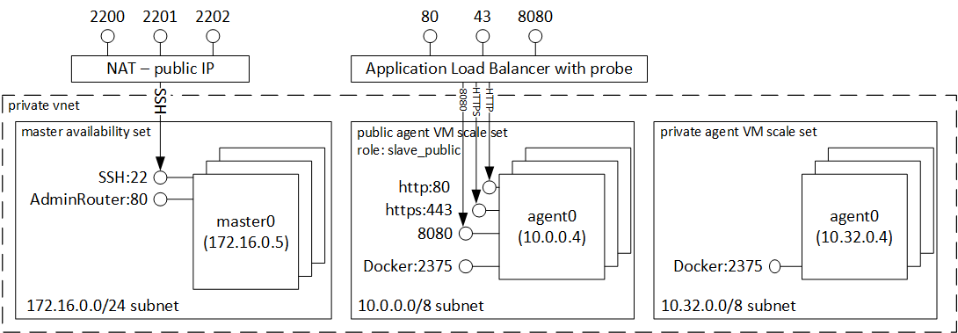
Azure Container Service Architecture (DC/OS)

Slide 21
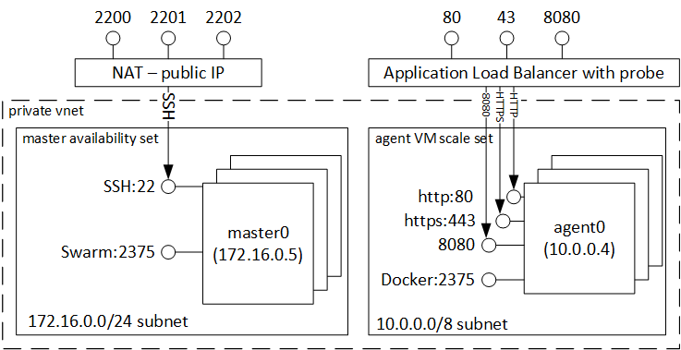
Azure Container Service Architecture (Swarm)

Slide 22
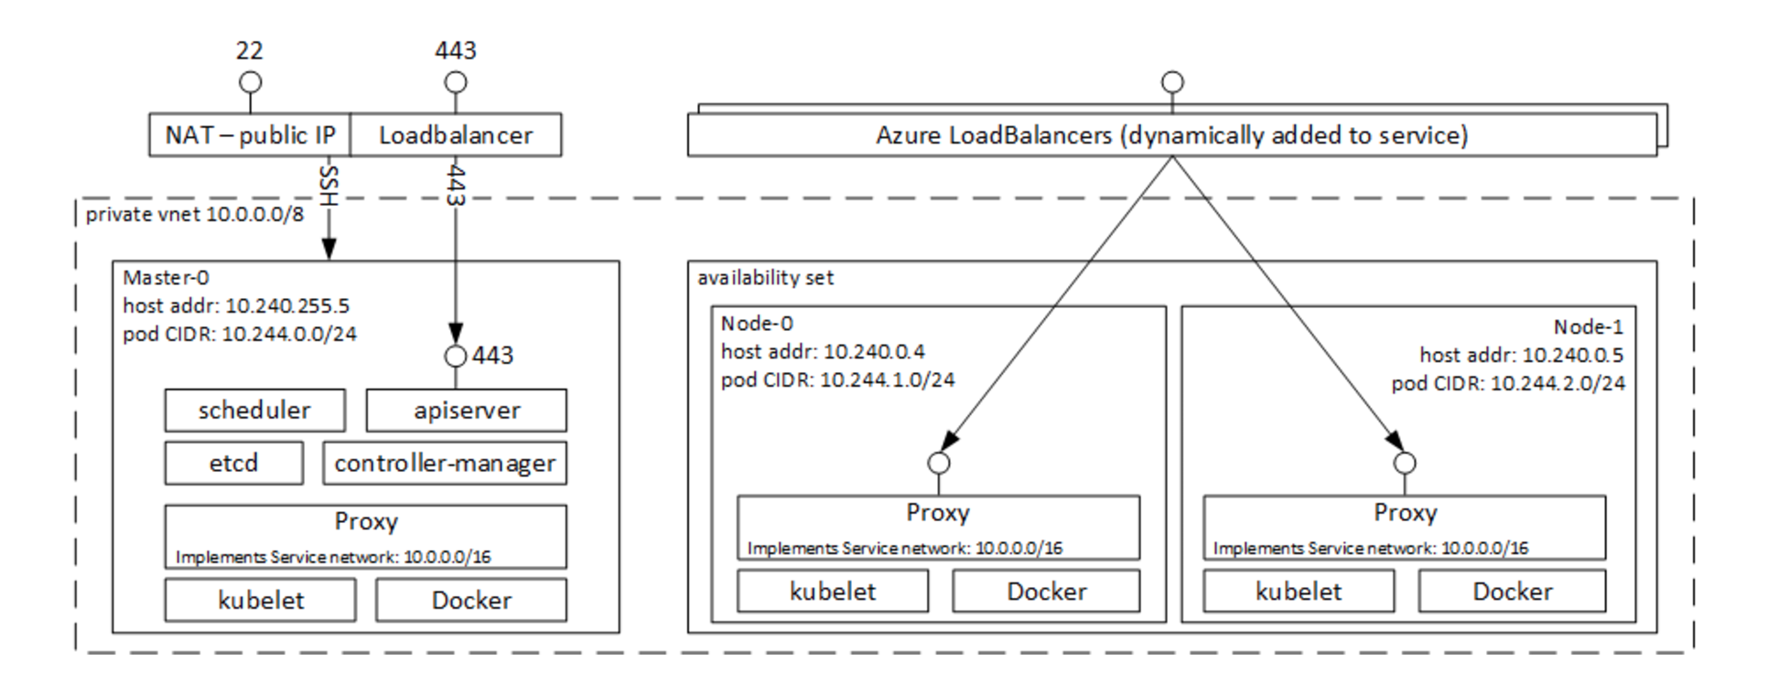
Azure Container Service Architecture (Kubernetes)

